Slide 1

Capstone Project – Final: Review – 1 on Secure Data Sharing in Cloud Using Attribute-Based Encryption (ABE)
Presented by the Batch No. : CS - 03
Patan Ahammad Sahid - BU22CSEN0400031 (TL)
Mohammed Mehraj Ahmed - BU22CSEN0400125 (TM-1)
Ranjith Gowda B M - BU22CSEN0400258 (TM-2)
Under the Guidance of
Nida Kousar G
Assistant Professor
Department of Computer Science and Engineering
GITAM School of AI & DS, GITAM (Deemed to be University),
Bengaluru, Karnataka, INDIA.

Slide 2
CONTENTS
Recap of Capstone Project Introduction Review-2
Problem Statement
Objectives and Project Workflow
Feedback from Guide/Reviewers and actions taken after Review–2
Methodology/Algorithms
Status of Implementation
Conclusion
References

Slide 3
Problem Statement
Loss of Data Confidentiality in Cloud Storage When sensitive data is stored on third-party cloud platforms, users must trust the service provider with their files. This results in loss of control over data confidentiality and increases the risk of data breaches and insider misuse.
Inadequate Access Control Mechanisms Existing cloud systems do not provide fine-grained, user-defined access control. Data owners cannot precisely control access based on user attributes such as role, department, or clearance.
Centralized Access Authorization Cloud storage systems use centralized authorization, creating a single point of failure. A single authority can grant or deny access, making the system vulnerable to insider threats and unauthorized access.

Slide 4
Objectives
Objective–1: Ensure confidentiality of shared files Encrypt every uploaded file using AES‑256 before storing, so data remains protected at rest and during transfer.
Objective–2: Provide fine‑grained, attribute‑based access control Define “who can access” each file using attribute policies (AND/OR rules) based on user attributes like role, department (dept), and clearance.
Objective–3: Enforce decentralized approval before decryption Require a blockchain-based threshold approval (4‑of‑7 authorities) for each access request so no single party can grant access alone.

Slide 5
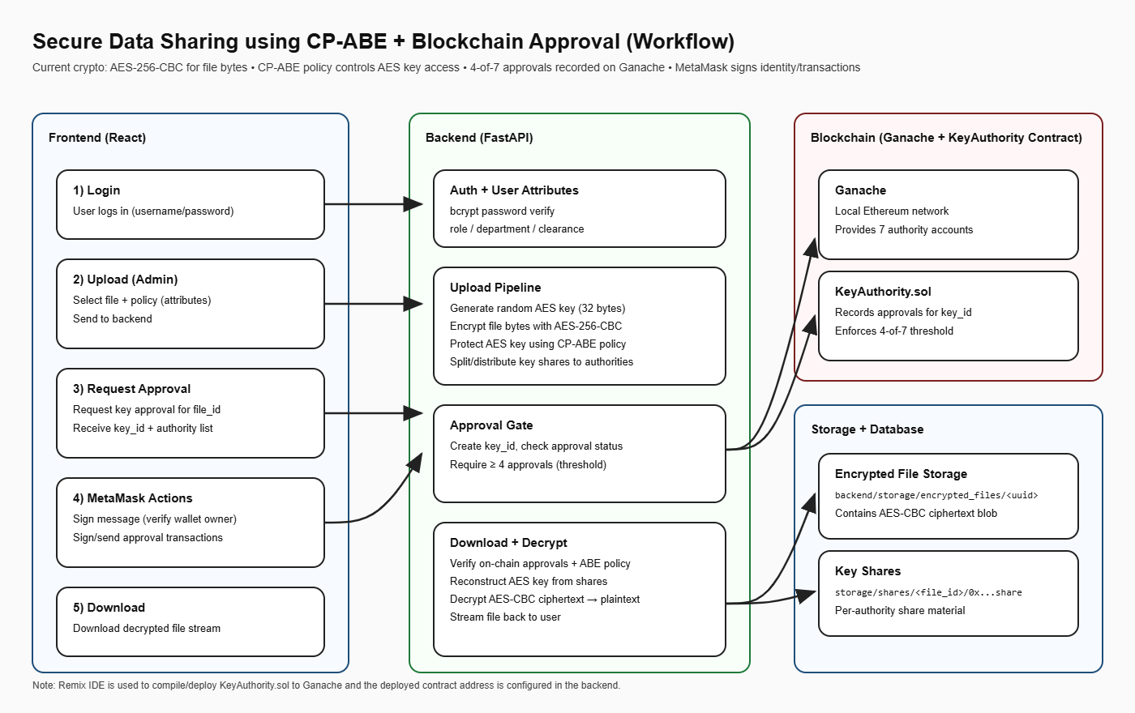
Design Strategy
Project Workflow

Slide 6
Feedback from Guide/Reviewers and actions taken after Review–2
Feedback from Guide/Reviewers
Asked to clearly specify what encryption algorithm is used to protect uploaded files.
Asked how access control is enforced so that unauthorized users cannot download files.
Asked to justify the need for blockchain-based approval instead of a centralized authority.

Slide 7
Actions taken
Clearly and documented AES-256 encryption for all uploaded files, ensuring data confidentiality at rest and during transfer.
Implemented attribute-based access control (AND/OR policies) using user attributes such as role, department, and clearance, and enforced policy checks before file download.
Integrated a blockchain-based threshold approval mechanism (4-of-7 authorities) to ensure decentralized, tamper-proof authorization before decryption

Slide 8
Methodology
Hybrid encryption methodology:
Encrypt large file data using symmetric AES (fast)
Secure the AES key using policy-based protection (ABE-style)
Attribute-policy access control:
User attributes such as role, dept, clearance
Policy expression uses AND/OR conditions- Blockchain-based threshold approval:
Multiple authorities vote on-chain - Access granted only when approvals meet threshold (4 of 7).
3. Local-first demo deployment:
SQLite DB for metadata
Ganache local blockchain for approvals

Slide 9
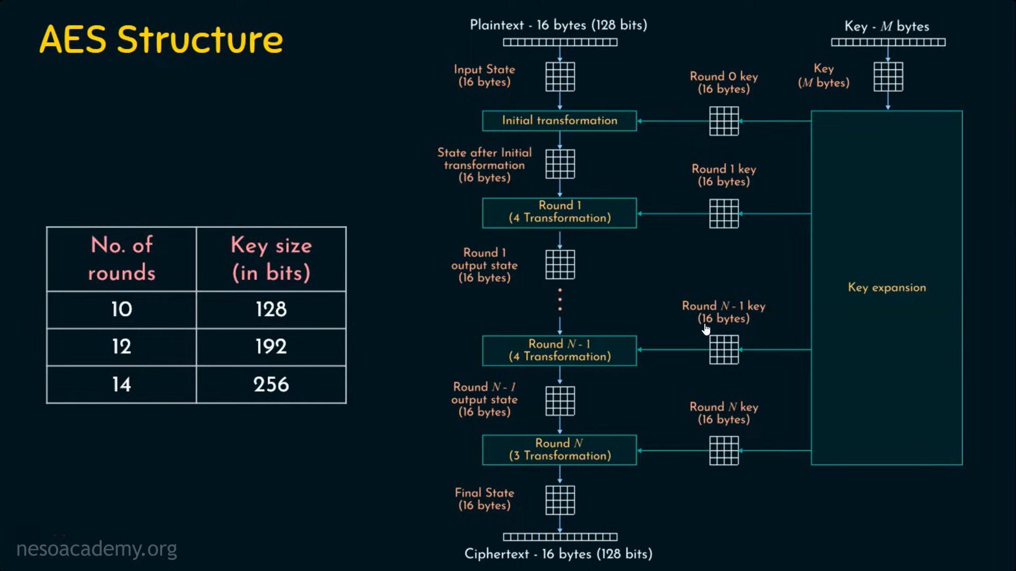
Algorithm (s)
AES-256-CBC (File encryption)
Key size: 256-bit (32 bytes)
IV: 128-bit (16 bytes), random
Padding: PKCS7

Slide 10
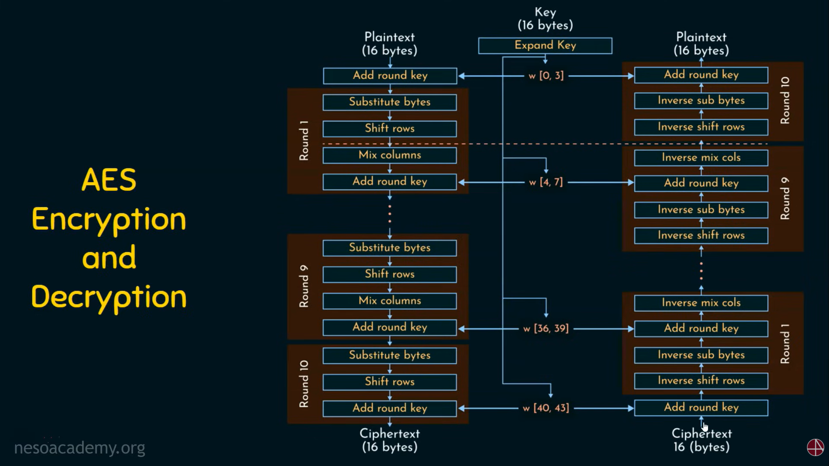
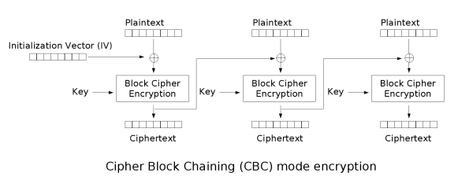
CBC MODE

Slide 11
Algorithm (s)
2. Policy evaluation (CP-ABE style logic)
Supports AND / OR groups, Example: (role:admin OR role:manager) AND (dept:IT OR dept:Finance) AND clearance:high3)
3. AES key protection (simulated CP-ABE key wrapping)
AES key is encrypted and stored along with policy
Decryption allowed only when user attributes satisfy policy
4. Blockchain threshold approval
Smart contract stores approvals count per key_id.
isApproved(key_id) returns true when approvals >= threshold (4)

Slide 12
Status of Implementation
Objective–1: Confidentiality of Shared Files ( Status of Implementation )
Implementation: Files are encrypted using AES-256-CBC with PKCS7 padding before storage. No plaintext file is stored at any stage.
Packages / Libraries: Python cryptography (Cipher, algorithms.AES, modes.CBC, padding.PKCS7).
Modules / Methods:
AES key generation: generate_aes_key() (32-byte key)
Encryption / Decryption: encrypt_file() → generates (IV, ciphertext), decrypt_file()
Upload flow: /files/upload encrypts file bytes and stores IV + ciphertext
Storage: Encrypted file saved in encrypted_files directory using a UUID filename

Slide 13
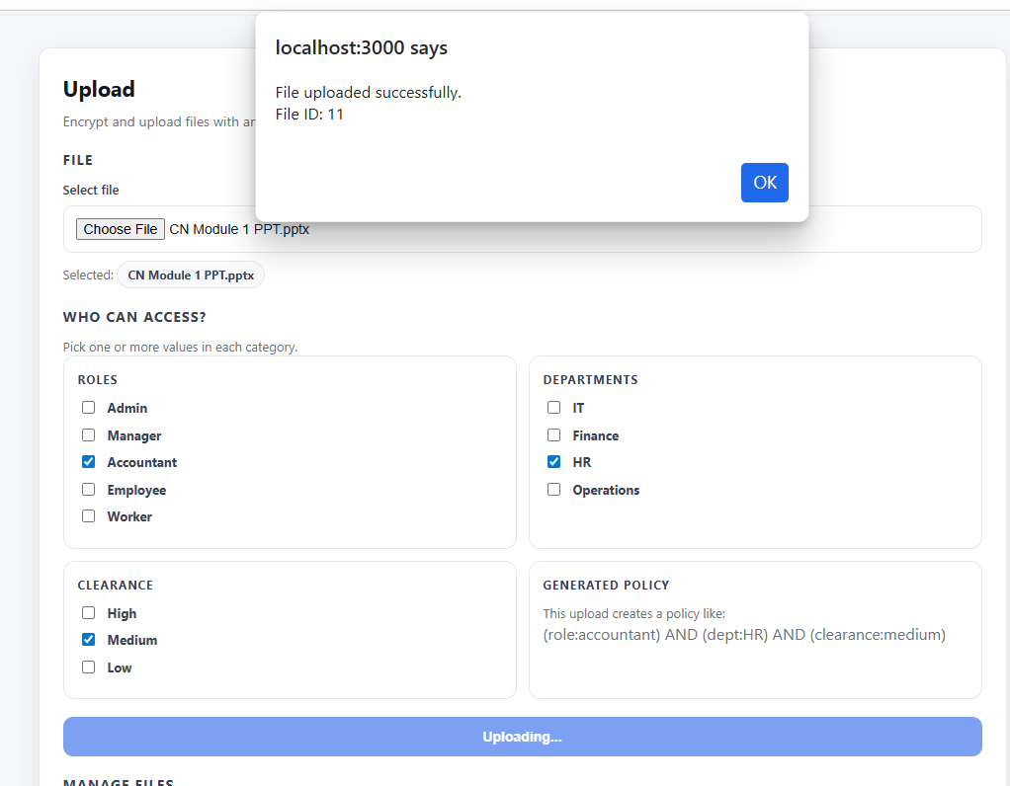
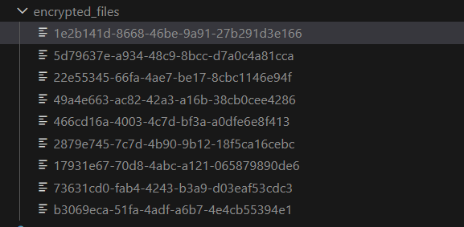
Screenshot (Result Proof):
Fig – 1.1: File upload success message (UI / API).
Fig – 1.2: Newly generated UUID file visible in encrypted_files directory.

Slide 14
Status of Implementation
Objective–2: Attribute-Based Access Control ( Status of Implementation )
Implementation: Each file is protected using an AND/OR attribute-based access policy. File download is permitted only when user attributes (role, dept, clearance) satisfy the defined policy.
Packages / Libraries: React (policy creation UI), Python backend (policy evaluation and enforcement).
Modules / Methods:
Policy creation during upload: Generates policy string such as (role:admin OR role:manager) AND (dept:IT OR dept:Finance) AND (clearance:high)
Backend policy validation: policy_satisfied(attributes, policy)
Enforcement point: Download flow blocks access if policy evaluation fails with message “Access denied by policy”.

Slide 15
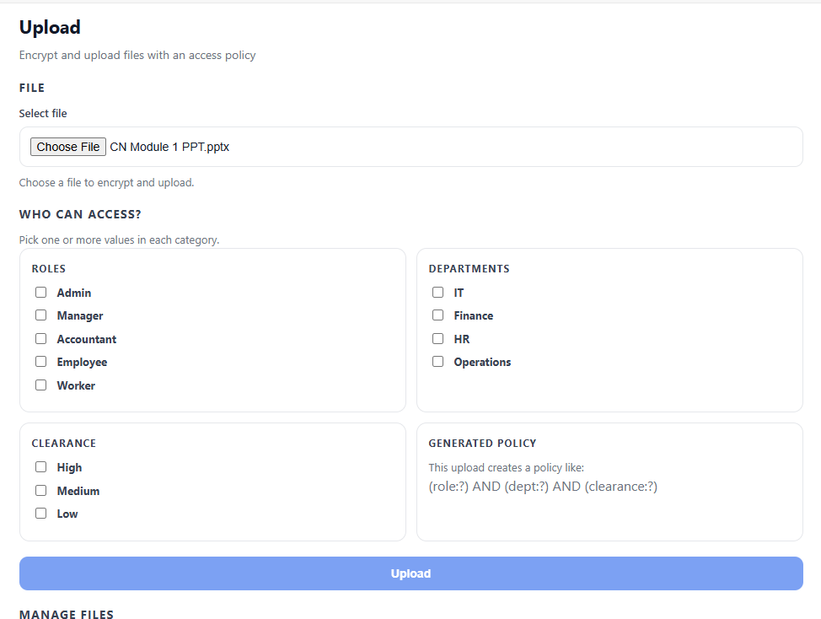
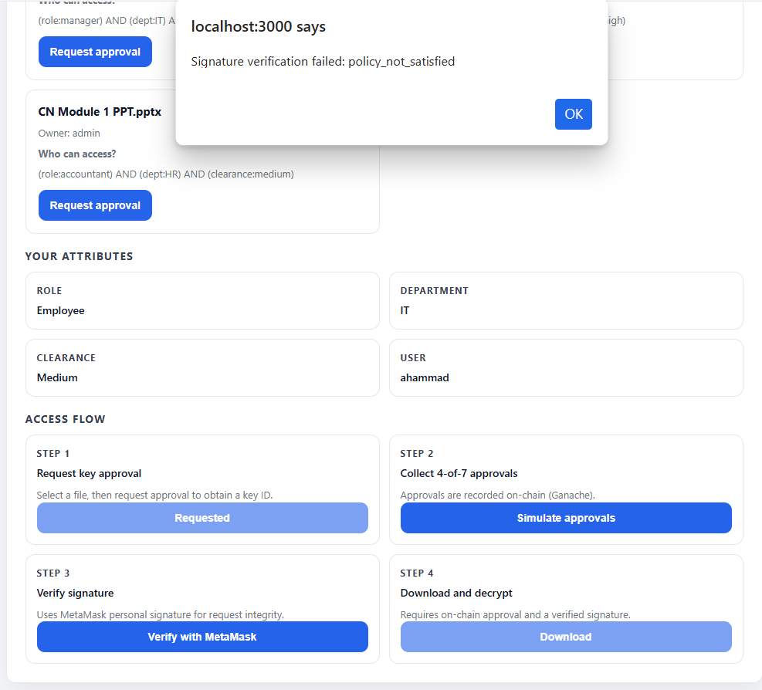
Screenshots (Result Proof):
Fig – 2.1: Upload page showing selected attributes and generated access policy (“Who can access?”) .
Fig – 2.2: Failed access attempt showing Access denied alert for a user with mismatching attributes.

Slide 16
Status of Implementation
Objective–3: Decentralized approval before decryption
( Status of Implementation )
Implementation: For every file access request, the system generates a unique key_id and enforces 4-of-7 authority approvals on blockchain (Ganache). File download and decryption are allowed only when the smart contract confirms that the threshold is reached.
Packages/Libraries:
Solidity smart contract (threshold voting)
web3.py (Python) for blockchain interaction
eth-account for signature and message handling (used in access verification flow)

Slide 17
Modules/Methods:
Smart contract: KeyAuthority.sol
approveKey(keyId) – authority submits approval
isApproved(keyId) – returns true when approvals ≥ threshold
Backend blockchain service: blockchain_auth.py
initiate_key_approval() – creates approval request and returns key_id
approve_key() – submits approval transaction (demo simulation)
verify_approval() / get_approval_status() – checks approval status from smart contract
API endpoints:
/api/access/request-key-approval – creates approval request
/api/access/simulate-approvals – submits 4 approval transactions for demo
/api/access/approval-status/{key_id} – shows current approval count
/files/download/{file_id} – blocks download if on-chain approval is not satisfied

Slide 18
Conclusion
The project successfully ensures confidentiality by encrypting every uploaded file using AES‑256 before storage, keeping data protected at rest and during transfer.
It provides fine‑grained access control using attribute‑based policies (AND/OR rules), so only users whose role, dept, and clearance satisfy the policy can decrypt the file.
It enforces decentralized control by requiring blockchain threshold approvals (4‑of‑7 authorities) before decryption, preventing any single party from granting access alone.

Slide 19
References
[1] Li, M., Yu, S., Zheng, Y., Ren, K., & Lou, W. (2012). Scalable and secure sharing of personal health records in cloud computing using Attribute-Based Encryption. IEEE Transactions on Parallel and Distributed Systems, 24(1), 131–143. https://doi.org/10.1109/tpds.2012.97
[2] Gajmal, Y., More, P., Jagtap, A., & Kale, K. (2024). Access control and data sharing mechanism in decentralized cloud using blockchain technology. Journal of Autonomous Intelligence, 7(3). https://doi.org/10.32629/jai.v7i3.1332
[3] Hwang, Y., Kim, S., Seo, D., & Lee, I. (2022). An SKP-ABE scheme for secure and efficient data sharing in cloud environments. Wireless Communications and Mobile Computing, 2022, 1–17. https://doi.org/10.1155/2022/1384405
[4] Ghoubach, I. E., Benabbou, R., & Mrabti, F. (2016). FP2E: Flexible, effective and privacy preserving cloud data sharing scheme. Cloud, 7–12. https://doi.org/10.1109/cloudtech.2016.7847691
[5] Zhao, M., Chen, H., Yao, Y. et al. Lattice-based ABE with multi-ciphertext equality test in cloud computing. J. King Saud Univ. Comput. Inf. Sci. 37, 38 (2025). https://doi.org/10.1007/s44443-025-00047-w

